Slide 1
PhD in Telematics Engineering
Traffic Prediction based on Big Data Technologies for Configuring Software-Defined Networks
M.Sc. FELIPE ESTRADA-SOLANO
Advisor: Ph.D. Oscar Mauricio Caicedo Rendon
University of Cauca
Telematics Department
Telematics Engineering Group
Popayan – Colombia
April 2016

Slide 2
Outline
Background
Motivation
Initial Approach
Systematic Mapping
Conclusions
Ph.D. study plan

Slide 3
Background
Background
Software-Defined Networking (SDN)
Traffic Engineering
Big Data

Slide 4
Background
Software-Defined Networking
Defines a new architecture for future networks
Separates the Data and the Control planes, allowing a simpler network operation from a logically centralized software program
Control Plane
Controller
Decision policies
SDN
SDN Protocol
Control Plane
Data Plane
Packet Forwarding
Data Plane
(Feamster et al., 2013) (Kim and Feamster, 2013)
(Anwer and Feamster, 2010) (Shimonishi and Ishi, 2010)

Slide 5
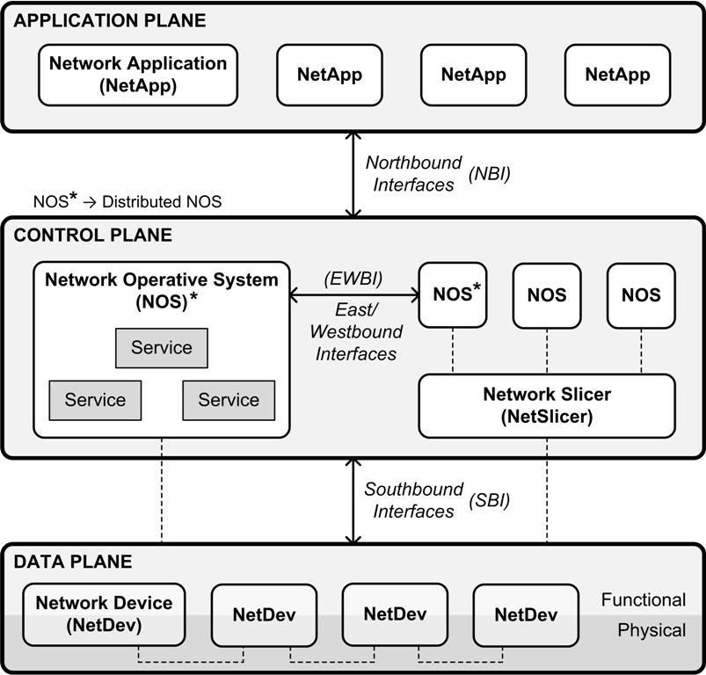
Background
Software-Defined Networking
Architecture
MANAGEMENT PLANE
Programming languages
Protocols
Open System Interconnection (OSI) network management
Information
Organizational
Communication
Functional
Information Model based on the Common Information Model
Mashup-based and Event-driven framework
Controller
Topology Discovering
Host Tracking
Openflow
(Estrada-Solano et al., 2016)
(Caicedo Rendon et. al., 2016, 2013)
(Wickboldt et al., 2015) (ONF, 2014)
(Efremova and Andrushko, 2015) (Kiran and Kinghorn, 2015)
(Kreutz et al., 2015) (Casado et al., 2014)
(Rijsman and Singla, 2013) (ONF, 2012)
Notes:
Open System Interconnection

Slide 6
Background
Traffic Engineering
Dynamic analysis, recognition, classification, prediction, and regulation of traffic behavior to improve network management.
e.g., classify traffic types to provide a suitable service in a very short time period
Traffic engineering for every SDN management functional area
Fault
Configuration
Accounting
Performance
Security
Programming
Traffic engineering with prediction is a promising approach to accommodate time-varying traffic without frequent route changes
e.g., avoid congestion on the basis of the predicted traffic
FCAPS+P model
(Estrada-Solano et al., 2016)
(Otoshi et al., 2015) (Akyildiz et al., 2014)

Slide 7
Background
Big Data
6 Vs
Volume vast amounts of data
Velocity data generated/analyzed speedily
Variety different types of data
Veracity integrity of the data
Variability different data flow rates
Value significant results
Different application domains
Government
Health
Networking
Short and long term benefits in the future Internet (e.g., SDN)
Collect and analyze huge amounts of data to obtain significant results for predicting events and improving decision-making
(Gandomi and Haider, 2015) (Marr, 2014)
(Mayer-Schönberger and Cukier, 2013)(Oracle, 2013)
(Agrawal et. al., 2012) (Laney, 2001)

Slide 8
Background
Big Data
Data Management
Acquisition and recording
Extraction, cleaning and annotation
Integration, aggregation and representation
Data Analytics
Modeling and analysis
Interpretation
Veracity
Value
Volume
Velocity
Variety
Variability
Source: (Free Video Lectures, 2015)
(Gandomi and Haider, 2015) (Nguyen, 2014)
(Labrinidis and Jagadish, 2012) (Jiang, 2012)

Slide 9
Motivation
Motivation
Centralized global view
Network state
Deployed applications
Dynamic programmability of multiple forwarding devices
Allocating resources to prevent congestion and improve performance
Open interfaces
Handling Data Plane
Developing Application Plane
Flexible flow management
Multiple flow tables in OpenFlow
Applications
Controller
Switch
Implement more efficient and intelligent management techniques
TRAFFIC ENGINEERING

Slide 10
Motivation
Traffic Engineering in SDN
MANAGEMENT
Applications
DATA
STORE
Controller
ANALYZE
Switch
CONFIGURE
DECIDE
Packet forwarding using traffic patterns to optimize network performance
Knowledge of relationships between network status and network configuration may help network to decide the best parameters according to real performance feedback

Slide 11
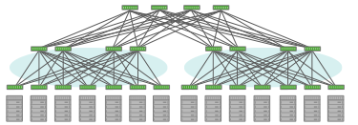
Motivation
Traffic Engineering in SDN
Applications
Applications
Huge
Controller
Controller
Switches
DATA
Traffic engineering in a data-intensive SDN environment?
BIG DATA

Slide 12
Initial Approach
Initial Approach
Address traffic engineering for configuring SDNs
– working along the network core –
with Big Data approaches

Slide 13
Initial Approach
Computer Networks Group
Traffic Engineering for SDN configuration using Big Data
Traffic
prediction/estimation
Ph.D.
M.Sc.
Undergraduate
Traffic
classification/recognition
BIG DATA
IETF & IRTF
Traffic
collection

Slide 14
Systematic Mapping
Systematic Mapping
Traffic Engineering in SDN
Research questions
Search process
Selection process
Initial results
(Kitchenman et al., 2009) (Petersen et al., 2008)

Slide 15
Systematic Mapping
Research Questions
RQ1. What are the different solutions for implementing traffic engineering in SDN?
RQ2. What research topics about traffic engineering in SDN are being addressed?
RQ3. What are the limitations of current investigation about traffic engineering in SDN?

Slide 16
Systematic Mapping
Search process
Search query
Keywords
“software-defined networking”
“traffic engineering“
Associated terms
Discard terms due to low search frequency → Google Trends
Discard terms aimed to other areas
("software-defined networking" OR openflow OR "software defined networking" OR "software defined network" OR "software defined networks“)
AND
("traffic engineering" OR "traffic management" OR "traffic analysis" OR "traffic monitoring" OR "traffic classification" OR "traffic prediction" OR "traffic steering")

Slide 17
Systematic Mapping
Search process
Number of papers per source and per year
Digital Library | Number of Papers
 | 2011 | 2012 | 2013 | 2014 | 2015 | TOTAL
ACM DL | 4 | 4 | 6 | 19 | 11 | 44
IEEE Xplore | 5 | 11 | 25 | 69 | 100 | 210
ScienceDirect | 4 | 4 | 24 | 58 | 82 | 172
SpringerLink | 7 | 10 | 27 | 45 | 87 | 176
TOTAL | 20 | 29 | 82 | 191 | 280 | 602
Inspec does not provide significant results
Most results from Google Scholar, Citeseer, and EI Compendex are included in the used digital libraries
(Brereton et al., 2007)

Slide 18
Systematic Mapping
Search process
Number of papers per source and per year

Slide 19
Systematic Mapping
Search process
Total number of papers per year

Slide 20
Systematic Mapping
Selection process
Selection criteria
Inclusion criteria
Propose traffic engineering solutions for managing SDN-based networks
Exclusion criteria
Literature review papers
Papers not subject to peer reviews

Slide 21
Systematic Mapping
Selection process
Candidate papers per source and per year
Digital Library | Number of Papers
 | 2011 | 2012 | 2013 | 2014 | 2015 | TOTAL
ACM DL | 4 | 1 | 5 | 16 | 10 | 36
IEEE Xplore | 5 | 11 | 18 | 58 | 87 | 179
ScienceDirect | 4 | 4 | 21 | 52 | 75 | 156
SpringerLink | 5 | 9 | 24 | 40 | 81 | 159
TOTAL | 18 | 25 | 68 | 166 | 253 | 407
Review title, abstract, and keywords
If poor information, then review conclusions

Slide 22
Systematic Mapping
Selection process
Selected papers
Digital Library | Number of Papers
 | 2011 | 2012 | 2013 | 2014 | 2015 | TOTAL
ACM DL | - | - | - | - | 8 | 8
IEEE Xplore | - | - | - | - | 58 | 58
ScienceDirect | - | - | - | - | 20 | 20
SpringerLink | - | - | - | - | - | -
TOTAL | - | - | - | - | 86 | 86
Review introduction and conclusions
If lack of relevant information, then review the whole paper
Selection in progress…

Slide 23
Systematic Mapping
Initial results
Traffic engineering in SDN regarding the FCAPS+P model
Load-balancing
Congestion avoidance
Fault tolerance
Anomaly detection
Policy update
Time-based
Intent-Based Networking (IBN)
Checking invariants
Debugging errors
Denial of Service
Malicious bots
Usage capabilities

Slide 24
Systematic Mapping
Initial results
Traffic engineering mechanisms in SDN

Slide 25
Systematic Mapping
Initial results
Classification scheme categories
Network context
Campus
Datacenters
Wide Area Networks (WAN)
Optical
Mobile
Data context
Non-data-intensive
Cloud
Big Data
Outcome
Algorithm
Architecture
Framework
Use case
Prototype

Slide 26
Conclusions
Conclusions
Applying traffic engineering for solving SDN configuration issues represents an interesting research topic
Traffic prediction in SDN presents an attractive research opportunity
Complementing the systematic mapping will provide better insight about traffic engineering in SDN
Which network context should be addressed in this project?
Which are the specific techniques for conducting traffic collection, classification, and prediction in SDN?
How many papers use Big Data for applying traffic engineering in SDN?

Slide 27
Ph.D. Study Plan
Ph.D. study plan
2016
Survey paper
IEEE Surveys and Tutorials
Review about using Big Data for managing SDN
Courses
Research Seminary I
Thesis III – Ph.D. thesis proposal
Research internship
University of Waterloo, Professor Raouf Boutaba
Conference paper
Initial results of research internship
COMPSAC 2017
* Journal/Conference paper
Systematic mapping study

Slide 28
Ph.D. Study Plan
Ph.D. study plan
2017
Journal paper
Conference paper
Courses
Research Seminary II
Teaching Practice
2018
Journal paper
Conference paper
Courses
Research Seminary III
Teaching Practice
Thesis IV – Ph.D. thesis

Slide 29
PhD in Telematics Engineering
Traffic Prediction based on Big Data Technologies for Configuring Software-Defined Networks
M.Sc. FELIPE ESTRADA-SOLANO
Advisor: Ph.D. Oscar Mauricio Caicedo Rendon
University of Cauca
Telematics Department
Telematics Engineering Group
Popayan – Colombia
April 2016

Slide 30
Traffic Prediction based on Big Data Technologies for Configuring Software-Defined Networks
FCAPS vs FAB
FCAPS
Fault, Configuration, Accounting, Performance, and Security
Telecommunications Management Network (TMN)
Built on the requirements to manage network equipment and networks (bottom-up)
Bottom-up / Network-centric approach
Network core
FAB
Fulfillment, Assurance, and Billing
Business Process Network (eTOM)
Built on the need to support processes of the entire service provider (top-down)
Information Technology Infrastructure Library (ITIL) presents the same approach
Top-down / Customer-centric / Business-centric approach
Service provider

Slide 31
References
Agrawal, D.; Bernstein, P.; Bertino, E.; Davidson, S.; Dayal, U.; M., F. …, Widom, J. (2012), 'Challenges and Opportunities with Big Data', Technical report, Computing Community Consortium, A white paper prepared for the Computing Community Consortium committee of the Computing Research Association. http://cra.org/ccc/resources/ccc-led-whitepapers/.
Akyildiz, I. F.; Lee, A.; Wang, P.; Luo, M. & Chou, W. (2014), 'A Roadmap for Traffic Engineering in SDN-OpenFlow Networks', Comput. Netw. 71, 1--30.
Anwer, M. B. & Feamster, N. (2010), 'Building a Fast, Virtualized Data Plane with Programmable Hardware', SIGCOMM Comput. Commun. Rev. 40(1), 75--82.
Brereton, P.; Kitchenham, B. A.; Budgen, D.; Turner, M. & Khalil, M. (2007), 'Lessons from Applying the Systematic Literature Review Process Within the Software Engineering Domain', J. Syst. Softw. 80(4), 571--583.
Caicedo Rendon, O. M.; Estrada-Solano, F. & Granville, L. Z. (2013), A Mashup-Based Approach for Virtual SDN Management, in 'Computer Software and Applications Conference (COMPSAC), 2013 IEEE 37th Annual', pp. 143-152.
Caicedo Rendon, O. M.; Estrada-Solano, F.; Guimarães, V.; Rockenbach Tarouco, L. M. & Granville, L. Z. (2016), 'Rich dynamic mashments: An approach for network management based on mashups and situation management', Computer Networks 94, 285 - 306.
Casado, M.; Foster, N. & Guha, A. (2014), 'Abstractions for Software-defined Networks', Commun. ACM 57(10), 86--95.
Efremova, L. & Andrushko, D. (2015), 'What's in OpenDaylight?', [Online]. Available: https://www.mirantis.com/blog/whats-opendaylight/.
Estrada-Solano, F.; Ordonez, A.; Granville, L. Z. & Caicedo Rendon, O. M. (2016), 'A CIM-based Information Model for Heterogeneous SDN Management', Computer Communications , Submitted to Computer Communications.
Feamster, N.; Rexford, J. & Zegura, E. (2013), 'The Road to SDN', Queue 11(12), 20:20--20:40.
Gandomi, A. & Haider, M. (2015), 'Beyond the hype: Big data concepts, methods, and analytics ', International Journal of Information Management 35(2), 137 – 144.

Slide 32
References
Jiang, J.Aggarwal, C. C. & Zhai, C., ed., (2012), Mining Text Data, Springer US, Boston, MA, chapter Information Extraction from Text, pp. 11—41.
Kim, H. & Feamster, N. (2013), 'Improving network management with software defined networking', Communications Magazine, IEEE 51(2), 114-119.
Kiran, S. & Kinghorn, G. (2015), 'Cisco Open Network Environment: Bring the Network Closer to Applications'(C11-728045-03), Technical report, Cisco.
Kitchenham, B.; Pearl Brereton, O.; Budgen, D.; Turner, M.; Bailey, J. & Linkman, S. (2009), 'Systematic literature reviews in software engineering – A systematic literature review', Information and Software Technology 51(1), 7--15.
Kreutz, D.; Ramos, F. M. V.; Esteves Verissimo, P.; Esteve Rothenberg, C.; Azodolmolky, S. & Uhlig, S. (2015), 'Software-Defined Networking: A Comprehensive Survey', Proceedings of the IEEE 103(1), 14--76.
Labrinidis, A. & Jagadish, H. V. (2012), 'Challenges and Opportunities with Big Data', Proc. VLDB Endow. 5(12), 2032--2033.
Laney, D. (2001), '3-D Data Management: Controlling Data Volume, Velocity and Variety'(949), Technical report, META Group.
Marr, B. (2014), 'Big Data: The 5 Vs Everyone Must Know', [Online]. Available: https://www.linkedin.com/pulse/20140306073407-64875646-big-data-the-5-vs-everyone-must-know.
Mayer-Schönberger, V. & Cukier, K. (2013), Big Data: A Revolution That Will Transform How We Live, Work, and Think, Eamon Dolan/Houghton Mifflin Harcourt.
Nguyen, H. (2014), 'Data Science vs Data Engineering', [Online]. Available: http://insightdataengineering.com/blog/Data_Science_vs_Data_Engineering.html.
ONF (2014), 'SDN architecture v1.0'(TR-502), Technical report, Open Network Foundation.
ONF (2012), 'Software-Defined Networking: The New Norm for Networks', Technical report, Open Network Foundation.
Oracle (2013), 'Ideas Economy: Finding Value in Big Data', The Economist, 2—19.

Slide 33
References
Otoshi, T.; Ohsita, Y.; Murata, M.; Takahashi, Y.; Ishibashi, K. & Shiomoto, K. (2015), 'Traffic Prediction for Dynamic Traffic Engineering', Comput. Netw. 85(C), 36—50.
Petersen, K.; Feldt, R.; Mujtaba, S. & Mattsson, M. (2008), Systematic Mapping Studies in Software Engineering, in 'Proceedings of the 12th International Conference on Evaluation and Assessment in Software Engineering', British Computer Society, Swinton, UK, UK, pp. 68—77.
Rijsman, B. & Singla, A. (2013), Day One: Understanding OpenContrail Architecture, Juniper Networks Books.
Shimonishi, H. & Ishii, S. (2010), Virtualized network infrastructure using OpenFlow, in 'Network Operations and Management Symposium Workshops (NOMS Wksps), 2010 IEEE/IFIP', pp. 74--79.
Wickboldt, J.; De Jesus, W.; Isolani, P.; Both, C.; Rochol, J. & Granville, L. (2015), 'Software-defined networking: management requirements and challenges', Communications Magazine, IEEE 53(1), 278—285.

