Slide 1
PhD in Telematics Engineering
Traffic Engineering with Prediction based on Big Data Technologies for Configuring Software-Defined Networks
M.Sc. FELIPE ESTRADA-SOLANO
Advisor: Ph.D. Oscar Mauricio Caicedo Rendon
Co-advisor: Ph.D. Nelson Luis Saldanha da Fonseca
University of Cauca
Telematics Department
Telematics Engineering Group
Popayan – Colombia
May 2016

Slide 2
Outline
Background
Motivation
Problem Statement
Hypothesis
Goals
Advance

Slide 3
Background
Background
Traffic Prediction
Software-Defined Networking (SDN)
Big Data
Background
Motivation

Slide 4
Traffic Prediction
Background
Traffic Information
Collect
Analyze
Predict
Network
Future Traffic
Anomaly detection
Admission control
Capacity planning
Traffic engineering
Configure
Knowledge of relationships between network behavior and network configuration may help to decide the best parameters according to real performance feedback
Traffic engineering with prediction is a promising approach to accommodate time-varying traffic without frequent route changes
e.g., congestion avoidance on the basis of the predicted traffic
(Otoshi et al., 2015) (Akyildiz et al., 2014)
Background
Motivation

Slide 5
Software-Defined Networking
Background
Defines a new architecture for future networks
Separates the Data and the Control planes, allowing a simpler network operation from a logically centralized software program
Centralized global view
Dynamic programmability of multiple forwarding devices
Open interfaces
Flexible flow management
Applications
Decision policies
Open APIs
Controller
SDN Protocol
Switch
Implement more efficient and intelligent management techniques
Traffic Engineering (TE)
Packet Forwarding
(Akyildiz et al., 2014) (Feamster et al., 2013) (Kim and Feamster, 2013)
(Anwer and Feamster, 2010) (Shimonishi and Ishi, 2010)
Background
Motivation

Slide 6
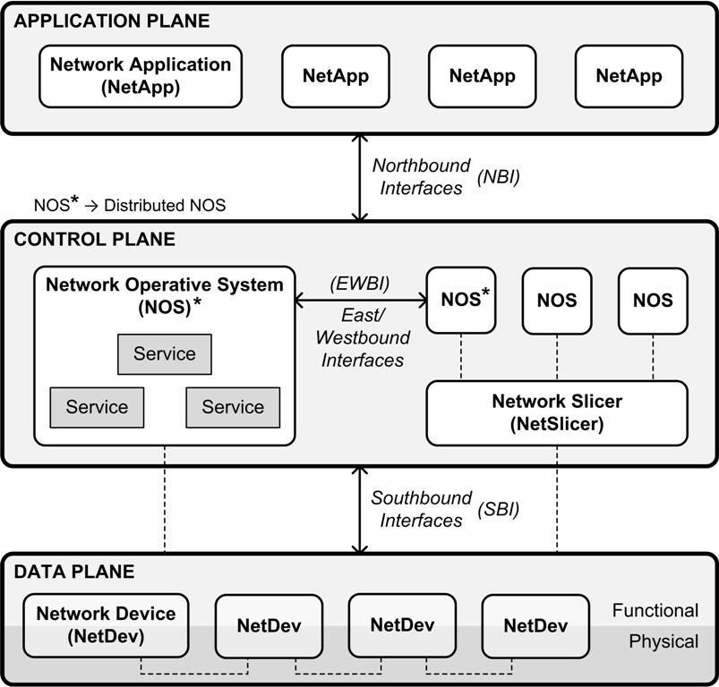
Software-Defined Networking
Background
Architecture
MANAGEMENT PLANE
Programming languages
Protocols
Open System Interconnection (OSI) network management
Information
Organizational
Communication
Functional
Information Model based on the Common Information Model
Mashup-based and Event-driven framework
Controller
Topology Discovering
Host Tracking
Openflow
(Estrada-Solano et al., 2016)
(Caicedo Rendon et. al., 2016, 2013)
(Wickboldt et al., 2015) (ONF, 2014)
(Efremova and Andrushko, 2015) (Kiran and Kinghorn, 2015)
(Kreutz et al., 2015) (Casado et al., 2014)
(Rijsman and Singla, 2013) (ONF, 2012)
Background
Motivation

Slide 7
Big Data
Background
Data Management
Acquisition and recording
Extraction, cleaning and annotation
Integration, aggregation and representation
Volume Terabytes Zettabytes⁺
Velocity Batch Streaming
Variety Structured Unstructured
Data Analytics
Modeling and analysis
Interpretation
Veracity Reliable Unreliable
Variable Constant Irregular
Valence Correlated Disconnected
Value Trivial Significant
Collect and analyze huge amounts of data to obtain significant results that allow predicting events and improving decision-making
(Gandomi and Haider, 2015) (Jagadish et al., 2014)
(Siewert, 2013) (Laney, 2001)
Background
Motivation

Slide 8
Motivation
Background
Applications
SDN requires to cope with traffic management
Time-varying traffic
Different traffic types
Redundant resource capacity
Overly large capacity
Low resource utilization
Costly and poor scalalability
Traffic management in SDN with limited resources
Avoid congestion
Optimize resource utilization
Controller
Switch
Implement more efficient and intelligent
traffic management techniques
Traffic Engineering (TE)
Background
Motivation
Problem Statement

Slide 9
Adaptive Traffic Engineering
Background
Applications
Adaptive TE
Analyze
Decide
Controller
Traffic data
Configuration
Switch
Use traffic patterns to improve network behavior
Drawbacks
Only observed traffic conditions, not future
Time-varying traffic
Heavy load
High traffic
Frequent configurations
Prediction
Background
Motivation
Problem Statement

Slide 10
Traffic Engineering with Prediction
Background
Applications
TE + Prediction
Data
Store
Controller
Analyze
Switch
Configuration
Predict
Use predicted traffic patterns to improve network behavior and reduce adaptive changes during a control period
Challenges
Prediction time-scale
Adaptive configurations
Background
Motivation
Problem Statement

Slide 11
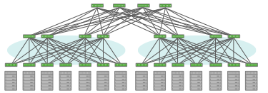
Traffic Engineering with Prediction
Background
Applications
Applications
Huge
Controller
Controller
Switches
Data
Challenge
Traffic Engineering with prediction in a data-intensive SDN environment
BIG DATA
Background
Motivation
Problem Statement

Slide 12
Problem Statement
Background
Due to the high variability of network traffic and the limited network resource capacity, performing traffic engineering for configuring SDN-based networks in a data-intensive environment remains ineffective in terms of time and traffic
How to carry out an effective approach
that performs traffic engineering for
configuring data-intensive SDNs?
Motivation
Problem Statement
Hypothesis

Slide 13
Hypothesis
Background
Carrying out traffic prediction supported by Big Data technologies – working along the network core – would lead to perform an effective traffic engineering for configuring SDN-based networks in a data-intensive environment
Problem Statement
Hypothesis
Goals

Slide 14
Goals
Background
Main Goal
Propose a mechanism based on Big Data technologies for implementing traffic engineering with prediction for configuring SDN-based networks in a data-intensive environment
Specific Goals
Characterize the relationships between network traffic and network configuration for SDN in a data-intensive environment
Design a framework for traffic prediction supported by Big Data technologies for conducting traffic engineering in a data-intensive SDN
Evaluate the effectiveness of the framework through an use case in an emulated data-intensive SDN environment
Hypothesis
Goals
Advance

Slide 15
Systematic Mapping
Background
Traffic engineering mechanisms in SDN
Goals
Advance

Slide 16
Systematic Mapping
Background
Traffic engineering in SDN regarding the FCAPS+P model
Load-balancing
Congestion avoidance
Fault tolerance
Anomaly detection
Policy update
Time-based
Checking invariants
Debugging errors
Denial of Service
Malicious bots
Usage capabilities
Goals
Advance

Slide 17
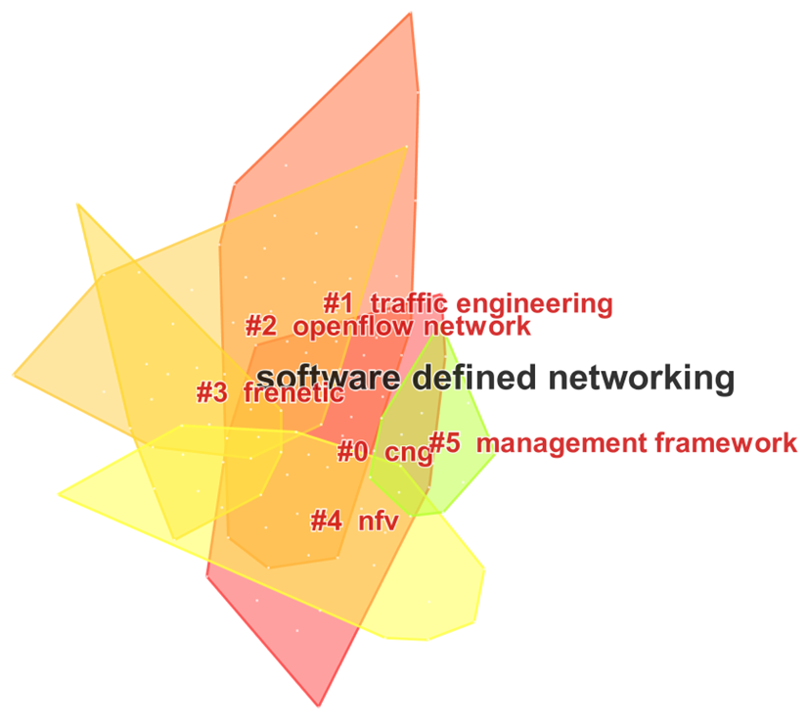
Systematic Mapping
Background
Configuration in SDN
SCOPUS + CiteSpace
Traffic engineering as one of the major areas of research
Associated terms
Datacenter network
Wide Area Network
Scalability
Capacity planning
Goals
Advance

Slide 18
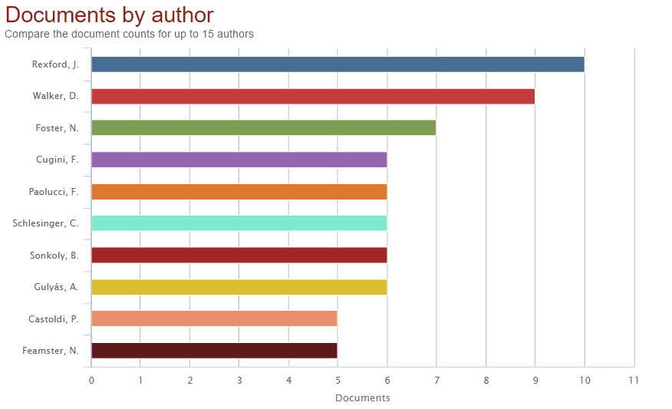
Systematic Mapping
Background
Configuration in SDN
Rexford, J.
Walker, D.
Foster, N.
Princeton University
Traffic engineering in SDN and conventional networks
Programming languages for SDN
Goals
Advance

Slide 19
Systematic Mapping
Background
Network Traffic Prediction Model based on Training Data
Prediction model
K-NN (K Nearest Neighbors) algorithm from road traffic prediction
Simulation results
Sub-optimal performance
Lack of historical data for extensive simulations
Dataset from Lincoln Laboratory
More recent from 2000
Intrusion detection dataset
Not an SDN deployment
Future work
Rebuild model for high precision
Real-time data
Comparison with other prediction models
(Park et al., 2015)
Goals
Advance

Slide 20
Systematic Mapping
Background
EMD-based Multi-model Prediction for Network Traffic in Software-Defined Networks
“Appropriate” traffic matrix
Reflect the traffic change trend of the future
Result of network traffic prediction algorithm
Algorithm EMD-MMP (Empirical Mode Decomposition Multi-Model Prediction)
Short-term forecasting algorithm
Decompose traffic series into different modes with different frequency by EMD
Better results than similar algorithms
ARMA (Auto-Regresive and Moving Average)
SVR (Support Vector Regression)
Dataset from Internet2
August 2008
Not an SDN deployment
(Dai et al., 2014)
Goals
Advance

Slide 21
Systematic Mapping
Background
Conclusions
Short-term forecasting approach
No configuration of an SDN-based network
SDN as a technology for collecting data
No data-intensive environment
Data fits in a single Controller
No dataset from an SDN deployment
Lincoln Laboratory → intrusion detection
Internet2 → conventional network *
Evaluate in an emulated SDN
Simulations
Goals
Advance

Slide 22
Next Steps
Background
Review traffic prediction for SDN in 2016
Review traffic prediction in any other kind of network
Describe two use cases for traffic engineering with prediction in a data-intensive SDN
Datacenter networks
Carrier networks
Review Big Data for managing SDN
Survey paper
Goals
Advance

Slide 23
PhD in Telematics Engineering
Traffic Engineering with Prediction based on Big Data Technologies for Configuring Software-Defined Networks
M.Sc. FELIPE ESTRADA-SOLANO
Advisor: Ph.D. Oscar Mauricio Caicedo Rendon
Co-advisor: Ph.D. Nelson Luis Saldanha da Fonseca
University of Cauca
Telematics Department
Telematics Engineering Group
Popayan – Colombia
May 2016

Slide 24
References
Akyildiz, I. F., Lee, A., Wang, P., Luo, M. & Chou, W. (2014). A Roadmap for Traffic Engineering in SDN-OpenFlow Networks. Comput. Netw. 71, 1--30.
Anwer, M. B. & Feamster, N. (2010). Building a Fast, Virtualized Data Plane with Programmable Hardware. SIGCOMM Comput. Commun. Rev. 40 (1), 75--82.
Caicedo Rendon, O. M., Estrada-Solano, F. & Granville, L. Z. (2013). A Mashup-Based Approach for Virtual SDN Management. In Computer Software and Applications Conference (COMPSAC), 2013 IEEE 37th Annual (pp. 143-152).
Caicedo Rendon, O. M., Estrada-Solano, F., Guimarães, V., Rockenbach Tarouco, L. M. & Granville, L. Z. (2016). Rich dynamic mashments: An approach for network management based on mashups and situation management. Computer Networks 94, 285 - 306.
Casado, M., Foster, N. & Guha, A. (2014). Abstractions for Software-defined Networks. Commun. ACM 57 (10), 86--95.
Dai, L., Yang, W., Gao, S., Xia, Y., Zhu, M. & Ji, Z. (2014). EMD-Based Multi-Model Prediction for Network Traffic in Software-Defined Networks. In 2014 IEEE 11th International Conference on Mobile Ad Hoc and Sensor Systems (pp. 539-544).
Efremova, L. & Andrushko, D. (2015). What's in OpenDaylight?. [Online]. Available: https://www.mirantis.com/blog/whats-opendaylight/
Estrada-Solano, F., Ordonez, A., Granville, L. Z. & Caicedo Rendon, O. M. (2016). A CIM-based Information Model for Heterogeneous SDN Management . Computer Communications (Submitted to Computer Communications)
Feamster, N., Rexford, J. & Zegura, E. (2013). The Road to SDN. Queue 11 (12), 20:20--20:40.
Gandomi, A. & Haider, M. (2015). Beyond the hype: Big data concepts, methods, and analytics . International Journal of Information Management 35 (2), 137 - 144.
Jagadish, H. V., Gehrke, J., Labrinidis, A., Papakonstantinou, Y., Patel, J. M., Ramakrishnan, R. & Shahabi, C. (2014). Big Data and Its Technical Challenges. Commun. ACM 57 (7), 86—94.

Slide 25
References
Kim, H. & Feamster, N. (2013). Improving network management with software defined networking. Communications Magazine, IEEE 51 (2), 114-119.
Kiran, S. & Kinghorn, G. (2015). Cisco Open Network Environment: Bring the Network Closer to Applications (White Paper C11-728045-03). Cisco.
Kreutz, D., Ramos, F. M. V., Esteves Verissimo, P., Esteve Rothenberg, C., Azodolmolky, S. & Uhlig, S. (2015). Software-Defined Networking: A Comprehensive Survey. Proceedings of the IEEE 103 (1), 14--76.
Laney, D. (2001). 3-D Data Management: Controlling Data Volume, Velocity and Variety (Research Report 949). META Group.
ONF (2014). SDN architecture v1.0 (Technical Reference TR-502). Open Network Foundation.
ONF (2012). Software-Defined Networking: The New Norm for Networks (White Paper ). Open Network Foundation.
Otoshi, T., Ohsita, Y., Murata, M., Takahashi, Y., Ishibashi, K. & Shiomoto, K. (2015). Traffic Prediction for Dynamic Traffic Engineering. Comput. Netw. 85 (C), 36--50.
Park, J., Raza, S. M., Thorat, P., Kim, D. S. & Choo, H. (2015). Computational Science and Its Applications – ICCSA 2015: 15th International Conference, Banff, AB, Canada, June 22-25, 2015, Proceedings, Part IV. In O. Gervasi, B. Murgante, S. Misra, L. M. Gavrilova, C. A. M. A. Rocha, C. Torre, D. Taniar & O. B. Apduhan (ed.), (pp. 117--127). Springer International Publishing. (ISBN: 978-3-319-21410-8.)
Rijsman, B. & Singla, A. (2013). Day One: Understanding OpenContrail Architecture. Juniper Networks Books.
Shimonishi, H. & Ishii, S. (2010). Virtualized network infrastructure using OpenFlow. In Network Operations and Management Symposium Workshops (NOMS Wksps), 2010 IEEE/IFIP (pp. 74--79).
Siewert, S. B. (2013). Big data in the cloud Data velocity, volume, variety, veracity (Technical Report ). IBM developerWorks.
Wickboldt, J., De Jesus, W., Isolani, P., Both, C., Rochol, J. & Granville, L. (2015). Software-defined networking: management requirements and challenges. Communications Magazine, IEEE 53 (1), 278--285.

Slide 26
FCAPS vs FAB
FCAPS
Fault, Configuration, Accounting, Performance, and Security
Telecommunications Management Network (TMN)
Built on the requirements to manage network equipment and networks (bottom-up)
Bottom-up / Network-centric approach
Network core
FAB
Fulfillment, Assurance, and Billing
Business Process Network (eTOM)
Built on the need to support processes of the entire service provider (top-down)
Information Technology Infrastructure Library (ITIL) presents the same approach
Top-down / Customer-centric / Business-centric approach
Service provider

